Slide 1
‘Digital B2B Market Place’.
RDK Meeting, 24th September 2021
Stefan Künzle, Alex Herrmann and Team

Slide 2
The ’Digital B2B Marketplace’ is now…
… MySwitzerland Pro!
myswitzerland is a strong B2C brand, which we’re herewith expanding into B2B and partnerships
Can be used as URL
CD is the same as myswitzerland.com
‘Marketplace’ is confusing.

Slide 3
Goals of MySwitzerland Pro.
ST is perceived as a digital leader, also among the global travel trade (ST Priorities 2021-2023: Digital Leadership)
ST creates additional, more balanced overnights and higher spending by facilitating the work of the global travel trade
ST creates added value for its partners/members
ST leverages its excellent global network of KAM managers and our top-rated events, the STMs

Slide 4
Idea of the MySwitzerland Pro.
Redesign match-making and trip planning through a digital platform for the global travel trade, KAMs & the Swiss tourism industry to
achieve more engagement and overnight stays (lagging and leading indicators are increased)
rationalise and standardise the KAM’s work processes, freeing up more time for relationship building
create added value for ST partners with a high quality offer
guest management can be targeted to prevent over-tourism

Slide 5
Requirements for MySwitzerland Pro.
Help qualifying buyers find selected suppliers in three categories: Activities, Accommodation, Transport
Comprehensive, attractive catalogues with multiple entry points and search functionalities
Connecting buyers and suppliers through trust and transparency
KAM as facilitators, creating measurable engagement
Build an ST-exclusive global community with most important buyers
Leverage platform for information and education

Slide 6
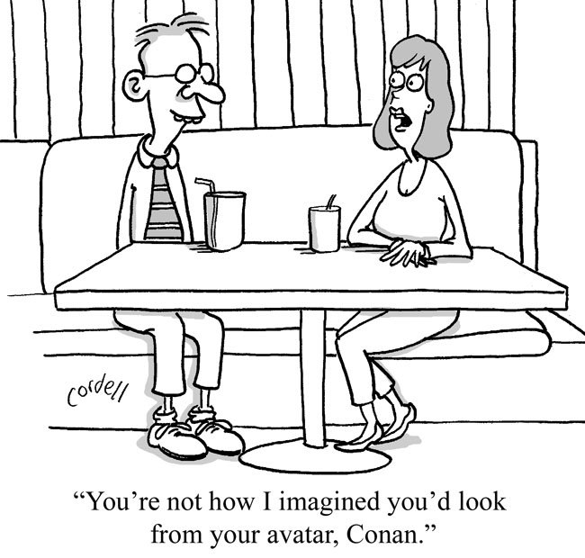
Our Solution? A Cocktail of…
40% dating app +

Slide 7
Our Solution? A Cocktail of…
40% dating app +
40% good old networking +

Slide 8
Our Solution? A Cocktail of…
40% dating app. +
40% good old networking +
25% ‘Q’.

Slide 9
Our Solution? A Cocktail of…
40% dating app +
40% good old networking +
25% ‘Q’.

Slide 10
Project Status.
Ideation started in September 2020.
Project and team up and running.
ST Management Board approved project/budget in June for 2021.
Multiple workshops conducted.
Interviews with almost 30 internal and external experts incl. representative RDK.
Booth at STM 2021 – with a Beta version!

Slide 11
MySwitzerland Pro - Demo
Buyers’ View
Map and Search
Detail Page
My Favorites
Itinerary Creation
Contact Inquiry
Suppliers’ View

Slide 12
MySwitzerland Pro - Demo.

Slide 13
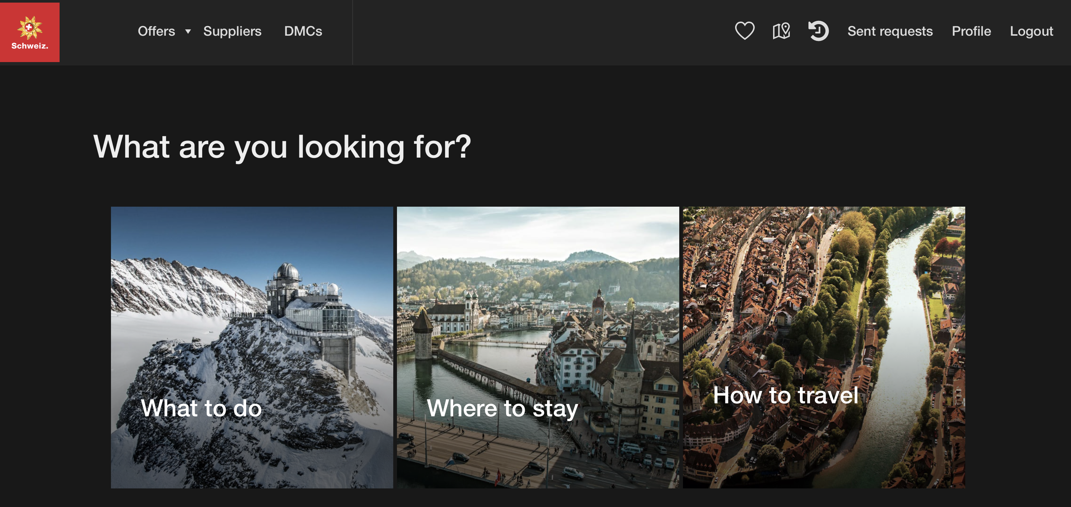
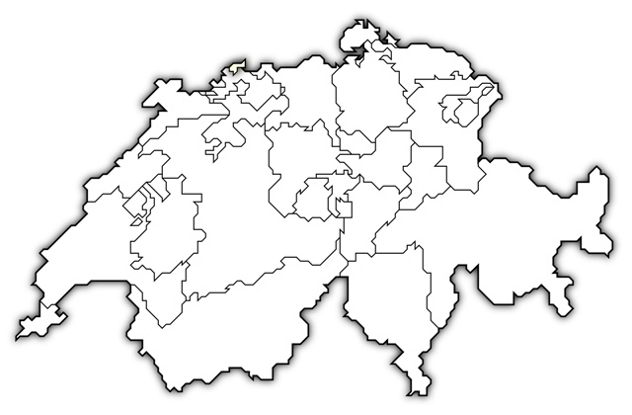
Role of Regions and Destinations.
Touristic Service
Providers
Regions /
Destinations
MySwitzerland Pro
WE NEED YOUR SUPPORT!
Create quality content
Quality check &
facilitation
Approved users & content
Notes:
Suppliers create the quality content the buyers are looking for.
Regions and Destinations are included as direct contacts plus as suppliers.
Final role of Regions and Destinations to be defined – role in overseeing ‘their’ suppliers.
We need the support of the Regions and Destinations!

Slide 14
Challenges.
Data and content
We use various, existing data sources, however, manual review required to ensure quality.
Existing content often avaliable in B2C context only.
Structured data key for further automation.
Reaching the critical mass
Chicken or egg. Buyers or Sellers.
First movers essential.
Mixed roles
Certain businesses fulfill multiple roles

Slide 15
Outlook.
Visit us at the STM Interlaken 11 – 12 October 2021, Table 12.
We continue to leverage upcoming global and local STM’s in 2022 to onboard new MySwitzerland Pro users – buyers as well as suppliers.
We stick to design thinking principles to prioritize upcoming features.
Quality over quantity: We will thoughtfully review the offerings and users to ensure a smooth and reliable experience.
We value your feedback, ideas and suggestions on how to increase value of the platform. Please get back to us.
https://www.youtube.com/watch?v=KVMEp1I2uHs

Slide 16
MySwitzerland Pro. MySwitzerland for travel professionals. Coming soon!

